Slide 1
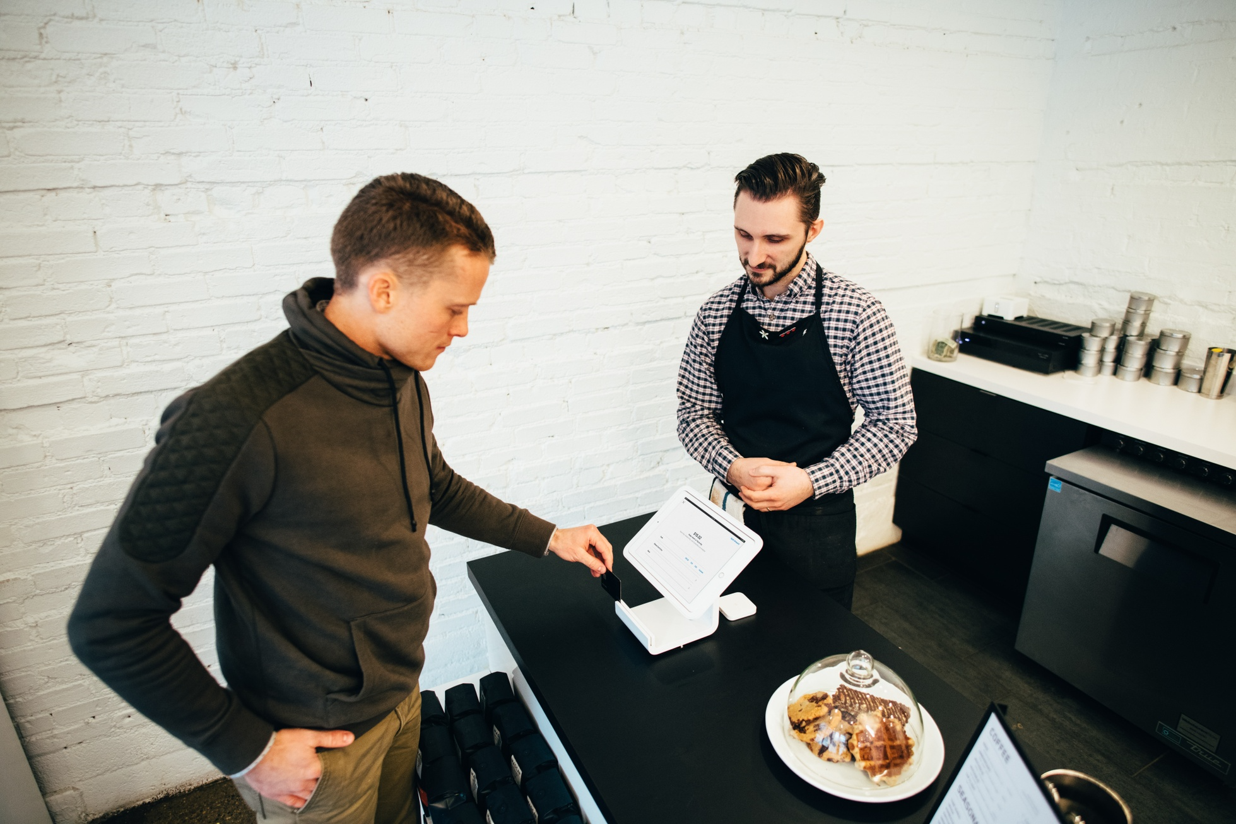
Predicting Customer Lifetime Value (CLV) to Optimize Targeted Marketing Strategies in E-Commerce
AN OVERVIEW OF HOW PREDICTING CUSTOMER LIFETIME VALUE (CLV) CAN HELP OPTIMIZE TARGETED MARKETING STRATEGIES IN THE E-COMMERCE INDUSTRY

Slide 2



OPTIMIZE RESOURCE ALLOCATION
PERSONALIZE MARKETING EFFORTS
ENHANCE STRATEGIC DECISION-MAKING
CLV prediction enables businesses to identify high-value customers and allocate marketing resources more efficiently to drive maximum returns.
Accurate CLV forecasts allow for the tailoring of loyalty programs, promotional campaigns, and product recommendations to individual customer preferences.
CLV insights empower businesses to make data-driven decisions, develop long-term customer engagement strategies, and maximize the lifetime value of each customer.
BY UNDERSTANDING THE CRITICAL ROLE OF CLV IN E-COMMERCE, BUSINESSES CAN OPTIMIZE THEIR MARKETING STRATEGIES, ENHANCE CUSTOMER EXPERIENCES, AND DRIVE SUSTAINABLE GROWTH.

Slide 3
Problem Statement
ENHANCE TARGETED MARKETING STRATEGIES
Develop effective marketing campaigns and resource allocation by accurately predicting Customer Lifetime Value (CLV) in a Brazilian e-commerce setting.
ACCURATELY PREDICT CUSTOMER LIFETIME VALUE (CLV)
Leverage a dataset of 100,000 anonymized orders from 2016 to 2018 to build a predictive model that can reliably estimate CLV for e-commerce customers.
OPTIMIZE MARKETING EFFORTS
Use the insights from CLV prediction to identify high-value customers, personalize marketing communications, and allocate resources more effectively to drive business growth.

Slide 4

Dataset Description
The primary dataset for this project was sourced from Kaggle and consists of 5 interrelated datasets covering various aspects of an e-commerce business in Brazil. These datasets include detailed information on customer orders, customer demographics, geographical locations, and payment methods used.

Slide 5




Data Wrangling
CUSTOMER-LEVEL AGGREGATES
RECENCY, FREQUENCY, MONETARY (RFM)
PRODUCT INTERACTION FEATURES
SHIPPING AND DELIVERY FEATURES
PAYMENT BEHAVIOR FEATURES
Derived features such as total orders, total spend, average order value, order frequency, and customer tenure to summarize each customer's interactions with the e-commerce platform.
Created features to capture the recency of the last purchase, the frequency of purchases made, and the monetary value of those purchases for each customer.
Crafted features including the number of unique products purchased, product category diversity, average product price, and total units purchased by each customer to understand their product preferences.
Derived features such as average delivery time, average shipping cost, and on-time delivery rate to gauge the impact of logistics and delivery on customer satisfaction and loyalty.
Created features to identify the preferred payment method, the average number of installments chosen, and the total number of payment transactions made by each customer.

Slide 6
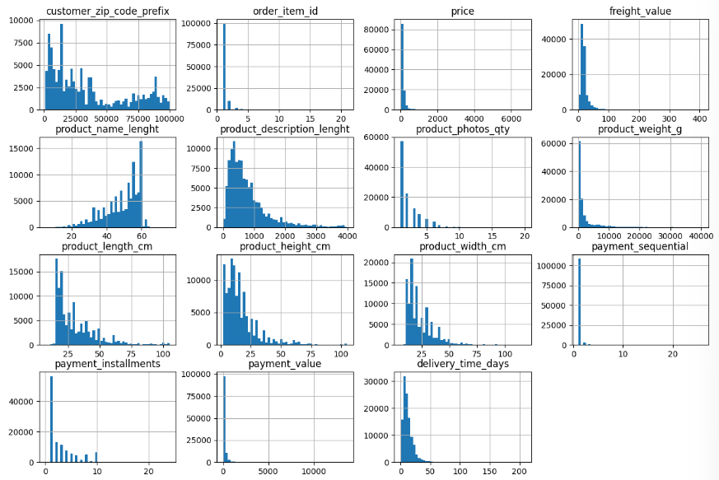
Exploratory Data Analysis
CUSTOMER SEGMENTATION
Most customers are low-frequency buyers with lower average order values and limited product diversity. However, a small segment of high-value customers (top 20%) accounts for about 80% of the revenue.

Slide 7
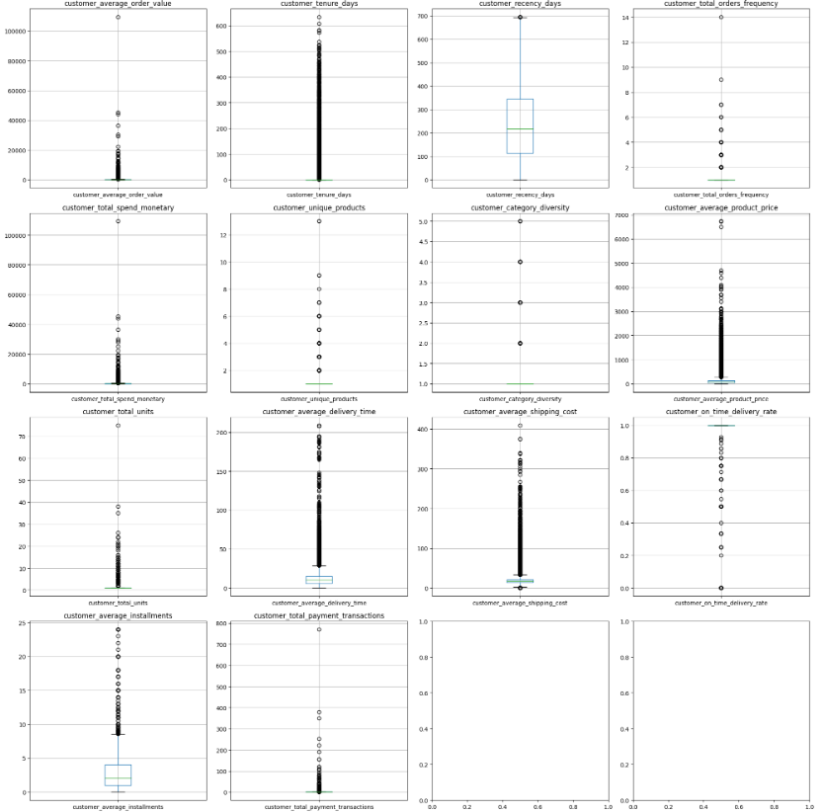
Exploratory Data Analysis
ORDER AND SPENDING PATTERNS
Boxplots revealed significant outliers and skewness, indicating higher average order values and total spend among a select group of high-value customers.

Slide 8
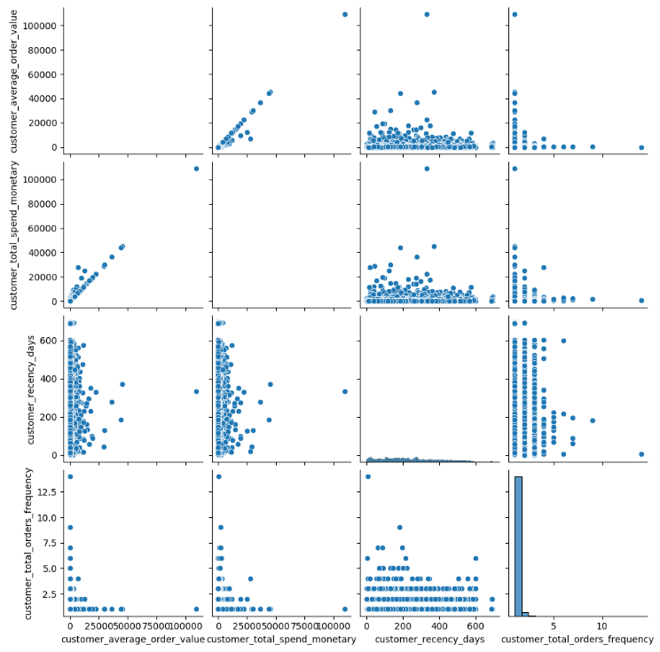
Exploratory Data Analysis
ORDER AND SPENDING PATTERNS
Pairplots highlighted a strong linear relationship between customer total spend and average order value.

Slide 9
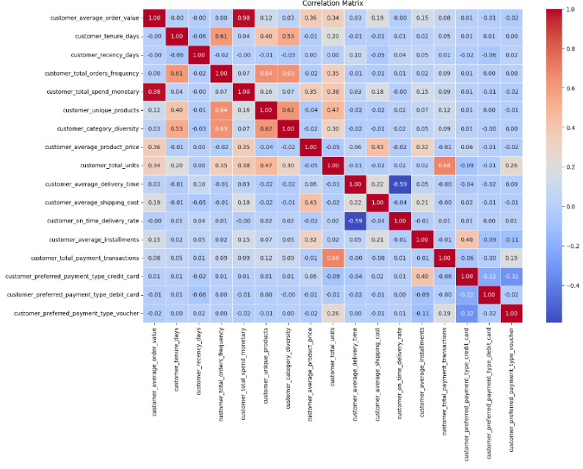
Exploratory Data Analysis
ORDER AND SPENDING PATTERNS
Correlation analysis showed that customers with longer tenures often display higher category diversity.

Slide 10
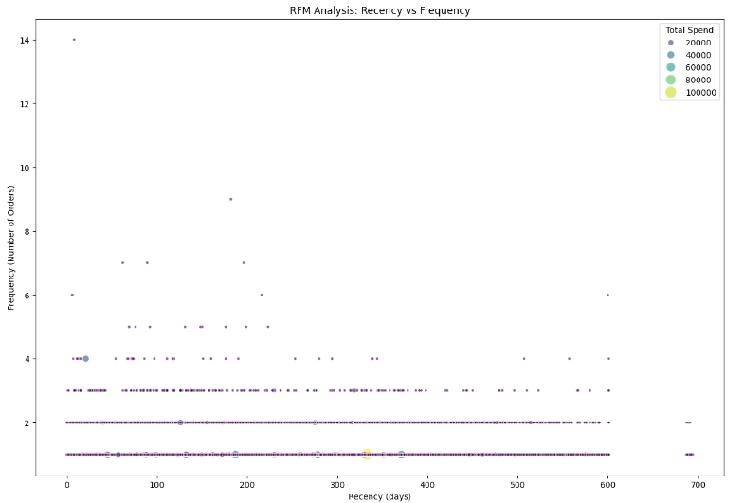
Exploratory Data Analysis
ORDER AND SPENDING PATTERNS
We see that most customers have a relatively low frequency of purchases, with a majority making between 1 and 3 purchases in our RFM analysis.

Slide 11
Exploratory Data Analysis
PAYMENT PREFERENCES
GEOGRAPHICAL INSIGHTS
DELIVERY & EXPERIENCE
There is a strong preference for using credit cards for transactions. Although other payment methods like 'boleto' and 'voucher' have some influence, they played a lesser role compared to credit card payments.
São Paulo and Rio de Janeiro are key geographical areas with high customer concentrations, making these regions strategic for targeted marketing efforts.
Average delivery time and shipping cost positively influenced CLV, implying that efficient logistics and delivery services contribute to higher customer value.

Slide 12
Modeling
EVALUATED MODELS
Linear Regression
Random Forest
Gradient Boosting
Lasso
Ensemble
Stacking
MOST EFFECTIVE: LASSO
Among the models, Lasso Regression emerged as the most effective, presenting a mean squared error (MSE) of 2352.66 and an R² score of 0.9821. This model provided the best balance between predictive accuracy and preventing overfitting.

Slide 13



Key Findings
CRITICAL FEATURES IMPACTING CLV: TOTAL ORDERS, TOTAL UNITS, AVERAGE ORDER VALUE
TOP 20% OF CUSTOMERS ACCOUNT FOR 80% OF REVENUE
CREDIT CARD DOMINANCE IN PAYMENT PREFERENCES
HIGH CUSTOMER CONCENTRATION IN SÃO PAULO & RIO DE JANEIRO

Slide 14
Recommendations
FOCUSED MARKETING CAMPAIGNS
Develop tailored strategies to retain and engage the top 20% of high-value customers through loyalty programs, exclusive offers, and personalized communications. Implement targeted promotions to convert low-frequency buyers into regular customers.
GEOGRAPHICAL TARGETING
Allocate more resources for marketing in São Paulo and Rio de Janeiro, the regions with the highest customer concentrations. Leverage regional promotions, localized advertising, and partnerships with local influencers to enhance engagement.
OPTIMIZE PAYMENT OPTIONS
While credit cards are the dominant payment method, promote alternative options like 'boleto' to diversify the customer base. Ensure seamless and secure payment processes for better customer experience.
ENHANCE CUSTOMER EXPERIENCE
Improve delivery times and reduce shipping costs where possible, as these factors positively affect CLV. Maintain high on-time delivery rates to foster customer satisfaction and loyalty.
PRODUCT DIVERSIFICATION
Encourage customers to explore a wider range of products through personalized recommendations based on past purchases, cross-selling, and up-selling techniques.
ENGAGEMENT AND RETENTION STRATEGIES
Focus on engaging customers with longer tenures by involving them in community-driven initiatives, feedback loops, and loyalty rewards. Reduce recency by re-engaging customers who haven't purchased in a while through reactivation campaigns, timely reminders, and attractive offers.

Slide 15

Ideas for Further Research
BEHAVIORAL SEGMENTATION
Explore clustering techniques to segment customers based on behavioral patterns beyond RFM (e.g., browsing habits, product preferences) to refine marketing tactics.
TIME SERIES ANALYSIS
Apply time series forecasting to predict seasonal trends and campaign impacts more precisely, enhancing strategic planning.
A/B TESTING FOR CAMPAIGNS
Implement A/B testing to determine the effectiveness of different marketing strategies and promotions, allowing for data-driven decisions on optimizing marketing efforts.
CUSTOMER FEEDBACK INTEGRATION
Incorporate qualitative data, such as customer reviews and feedback, to enhance the predictors used in the CLV model. Sentiment analysis and natural language processing techniques can provide insights into customer satisfaction and uncover potential areas for improvement.

Slide 16

Conclusion
A robust Lasso regression model achieved precise CLV predictions that offer actionable insights for targeted marketing, optimized product offerings, and improved customer experiences. These strategies can drive business growth and maximize ROI. Implementation of these recommendations and pursuing further research will enable even deeper customer insights and enhance long-term business strategies.

